Slide 1



Agile & Scrum
for Leadership

Slide 2
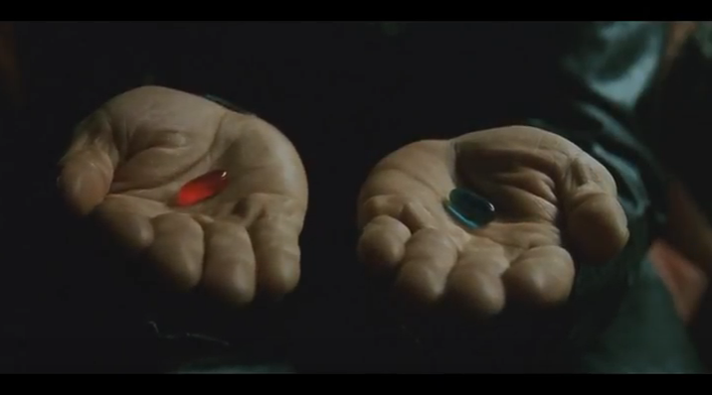
Choose
One
“You take the blue pill, the story ends. You take the red pill, you stay in Wonderland, and I show you how deep the rabbit hole goes.” - The Matrix

Slide 3
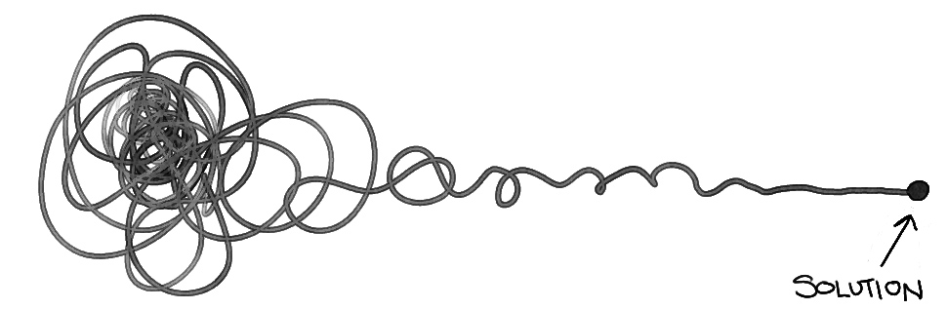
How might we respond to change and uncertainty?
Notes:
In a world of increasing market volatility, shorter product life cycles, higher product complexity, and global supply chains, Adient must grow both the culture and capabilities to become more flexible and responsive to business trends and demand changes.
This the only way we can consistently deliver on our strategic business goals as outlined in our 5 Year Marker.
Across the organization we’re starting to explore how technology accelerators like Industry 4.0 and advanced Analytics can help us digitize our production cycle and effectively use data from product development, services and manufacturing to accelerate decision making, increase efficiency and lead to faster product improvements.
To do this we need to change more than just the way we deliver. We need to encourage a mindset that promotes a culture of collaboration, adaptability, engagement and accepting (and leveraging) uncertainty.
That is why we’ve started this Agile journey and developed a framework to help Adient define and deliver value faster to our stakeholders.

Slide 4

What is Agile?
Chaos
A Cult
A Methodology?
No Planning
An Approach?
No Discipline
Something we’re
already doing …?
No Documentation
Process?
No Architecture
A Fad
A Framework? SDLC?
Like Waterfall …
but iterative?

Slide 5
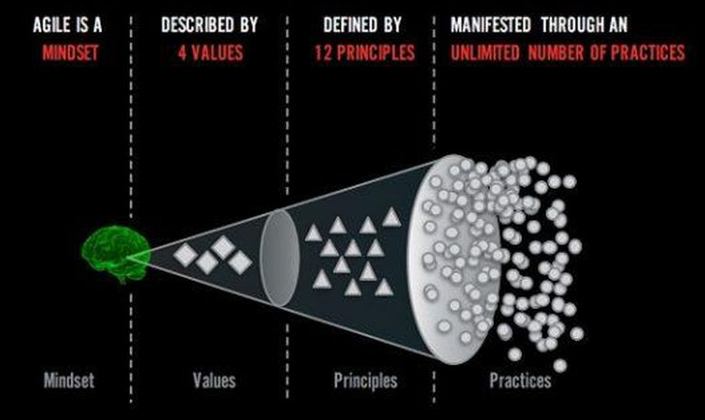
What is Agile?
Ref: Adopted from Ahmed Sidky
Notes:
Agile is a MINDSET described by Values defined by PRINCIPLES and manifested through many different practices

Slide 6
Agile Mindset
A mindset is an established set of attitudes. It is our consciousness, our way of being, how we behave and what we value. It is our organizational culture.
The Agile Mindset emphasizes:
Expect and embrace change
Focus on rapid value delivery – identify the most important thing and get it done
When in doubt, defer decisions to the last responsible moment
Get started as quickly as possible and learn as we go – inspect and adapt
Only do what is needed and no more – the simplest thing
Organize work so we get working product into the hands of our customer as quickly as possible – focus on incremental, iterative development
Organize the work to leverage the power of collaborating teams

Slide 7
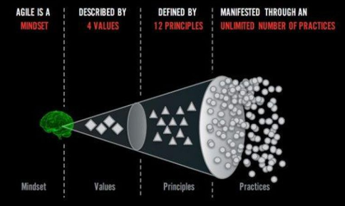
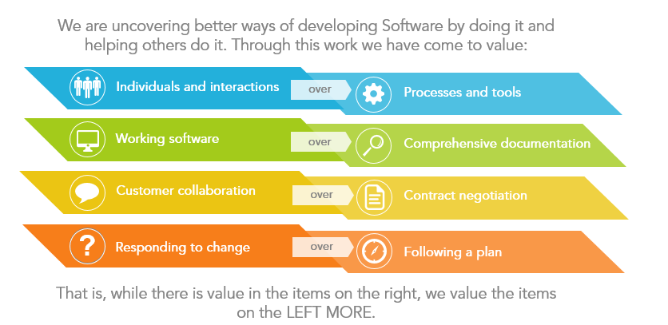
Four Values
value over
value over
value over
value over
While we recognize the value of the items on the right, we value the items on the left more.
Ref: https://agilemanifesto.org
Notes:
Max

Slide 8
Twelve Principles
01 Our highest priority is to satisfy the customer through early and continuous delivery of valuable software.
02 Welcome changing requirements, even late in the development. Agile processes harness change for the customer’s competitive advantage.
03 Deliver working software frequently, from a couple of weeks to a couple of months, with a preference to the shorter timescale.
04 Business people and developers must work together daily throughout the project.
05 Build projects around motivated individuals. Give then the environment and support they need, and trust them to get the job done.
06 Agile processes promote sustainable development. The sponsors, developers and users should be able to maintain a constant pace indefinitely.
07 Working software is the primary measure of progress.
08 The most efficient and effective method of conveying information to and within a development team is face-to-face conversation.
09 Continuous attention to technical excellence and good design enhances agility.
10 Simplicity – the art of maximizing the amount of work not done – is essential.
11 The best architecture, requirements and designs emerge from self-organizing teams.
12 At regular intervals the team reflects on how to become more effective, then tunes and adjusts its behavior accordingly.
Ref: https://agilemanifesto.org

Slide 9
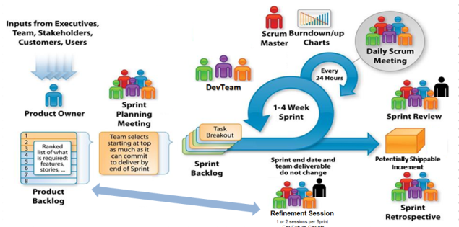
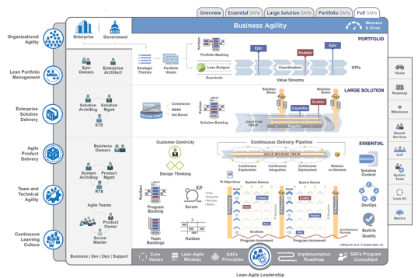
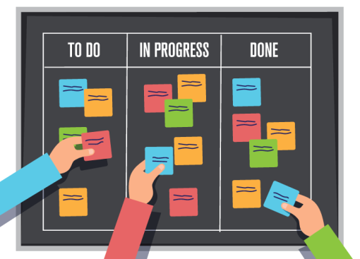
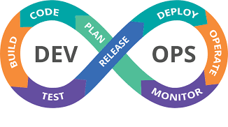
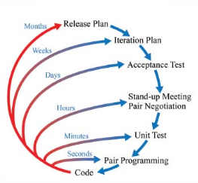
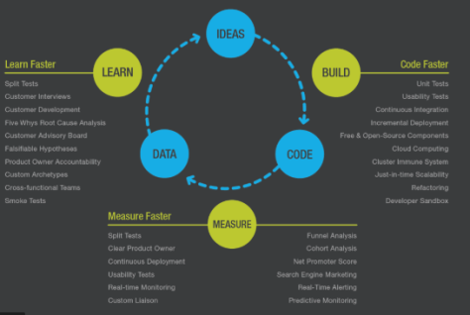
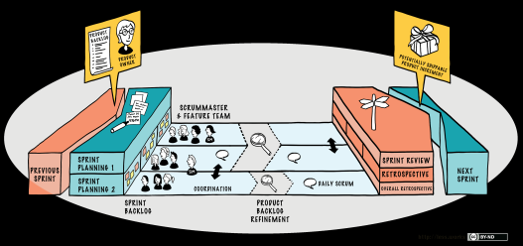
Unlimited Practices

Slide 10
For Sustainable Agile, Leaders and Teams Must Be Agile, Not Just Do Agile
Doing Agile
Learning and applying Agile practices, tools and frameworks without knowing the principles behind them and without knowing when to tailor and select practices.
Being Agile
Embracing the Agile Mindset. Internalizing the 4 Values and 12 Principles. Applying the right practices and knowing when to tailor them to different projects and situations.
Both are a means to drive value and impact productivity and speed in the organization but Being Agile is a transformational journey that can fundamentally redefine your culture and purpose.
Notes:
Mindset
Iterative
Feedback
Collaboration Empowerment Self-Organized Value-Driven
Learning
Transparency

Slide 11
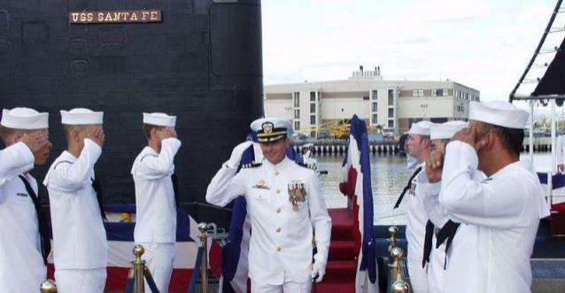
Role of the Servant Leader- David Marquette Story
“Great leaders GIVE CONTROL. They don’t take control. ”
- Capt. David Marquet
Notes:
Play video:
https://www.youtube.com/watch?v=OqmdLcyES_Q

Slide 12
Servant Leader Traits
Provides Control, Competence, Clarity
Acts with humility – don’t need to use authority, use influence
Creates trust – builds community
Values diverse opinions
Allows room for the team to learn
Grows their people and develops teams
Makes sure the team has the resources needed to get their work done
Removes impediments so the team can get their work done

Slide 13
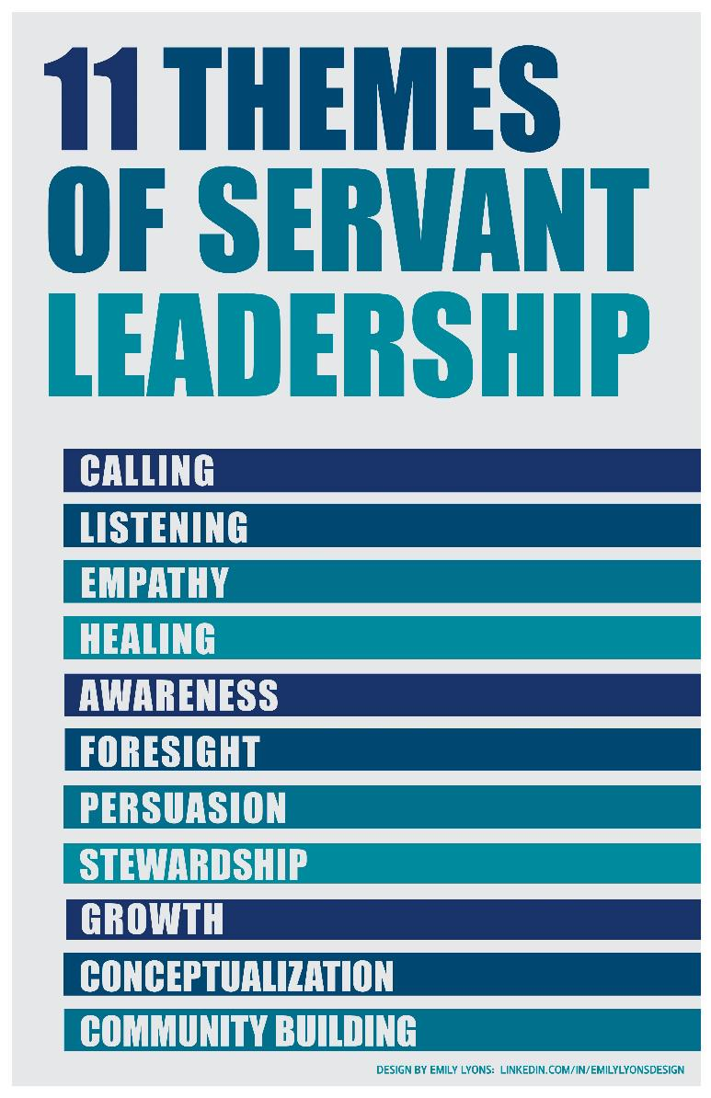
Success is Rooted in Servant Leadership
Agile leadership is rooted in service.
Robert Greenleaf first defined and coined the term ‘servant leadership’. In simple words, it means the leader puts others first, with an aim to achieve results for the organization by keeping in mind the needs of the people.
Agile leadership at every level of the organization and project is necessary for the success of an Agile transformation.

Slide 14
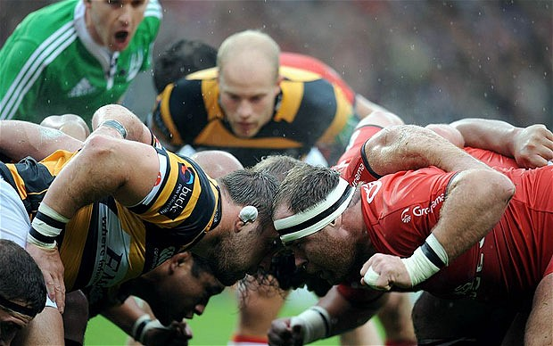
Scrum

Slide 15
“Scrum will help you fail in 30 days or less.”
- Ken Schwaber
Notes:
Talk about pilot team experience

Slide 16
What is Scrum?
A framework imbibing Agile values and principles
A process framework that relies on inspect and adapt cycles
Delivers business functionality every 30 days
A transparent approach for technical and business to have an ongoing conversation
Easy to understand and can be implemented right away

Slide 17
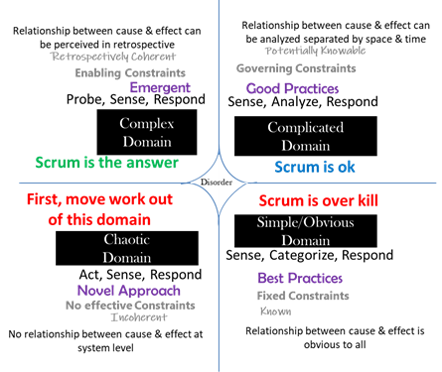
When to use Scrum?
Ref: http://agileanswer.blogspot.com/2019/12/when-not-to-use-scrum.html

Slide 18
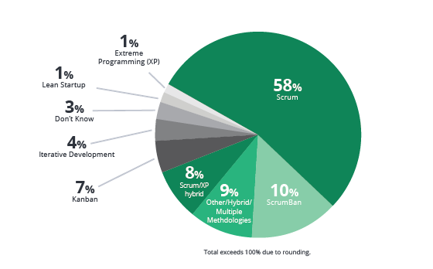
Who is using Scrum?
Ref: 14th Annual State of Agile Report - May 26, 2020

Slide 19
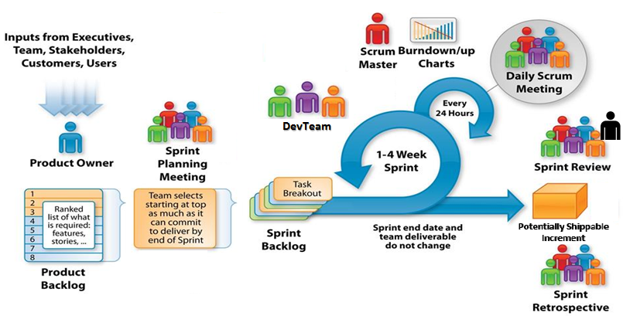
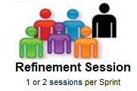
When to use Scrum?
For Future Sprints
Adapted from: http://csharpcorner.mindcrackerinc.netdna-cdn.com/UploadFile/BlogImages/11292015063901AM/SystemsPlus-Scrum-Image-.jpg

Slide 20

Scrum: Elements of Core Framework
SCRUM
SCRUM
Scrum is the basic building block of Scrum at Scale Framework.
ROLES
EVENTS
ARTIFACTS
Product Owner
Scrum Master
Scrum Team
Product Backlog
Epics
Features
User Stories
Sprint Backlog
Sprint Burn down Chart
Sprint Planning Meeting
Daily Scrum/Standup
Sprint Review Meeting
Sprint Retrospective
plus Backlog Refinement
ARTIFACTS
ROLES
CEREMONIES
Proxy Product Owner
Proxy Scrum Master
Scrum at Scale with Distributed Teams
Scrum of Scrums
Distributed Scrum at Scale

Slide 21



Scrum Roles
For the successful implementation of the Scrum framework, the following roles are involved:
The Product Owner is responsible for defining the vision/value of the product to maximize the value of the work of the Development Team
Product Owner
Scrum Team
The Scrum Team is a cross functional group of talented people with different skills, working together, committed to completing a sprint
The Scrum Master is responsible for making sure a Scrum team lives by the values and practices of Scrum and is a Coach, Mentor and Guide to the team
Scrum Master
Notes:
There is no Leader role in Scrum. Does that leaders are not necessary?

Slide 22
Scrum Events
Scrum Events are forums to collaborate, provide feedback, identify interdependencies, remove blockers, and plan for future sprints. There are 4 official Scrum Events plus1.
Sprint Planning
Team meets with the Product Owner and commits to a set of work to deliver during a sprint
Daily Stand Up
Team meets each day for 15 minutes to individually share progress, next steps and impediments
Sprint Review
Team demonstrates to the Product Owner what has been completed during the sprint
Sprint Retrospective
Team reflects on what worked and what didn’t during the sprint and looks for ways to improve the product and the process
Backlog Refinement
Five to ten percent of every Sprint should be dedicated to Product Backlog Refinement. This is not for users stories selected for the current sprint; it is for items in future sprints. Includes detailed requirements analysis, splitting large items into smaller ones (epics to use stories), estimation of new items, re-estimation of existing items

Slide 23
Scrum Artifacts
There are three key artifacts in Scrum:
Product Backlog
The Product Backlog prepared by the Product Owner contains a list of user stories, which are smallest units of value to deliver.
These are prioritized by business value inside the backlog.
The list should include all functionality and features visible to the customer, as well as the technical non functional requirements . These technical pieces are call “enabler stories.”
Sprint Backlog
The Sprint Backlog is a detailed list containing information about which requirements (user stories) the team is going to implement and how the team is going to implement these requirements in the upcoming Sprint.
Tasks on the Sprint Backlog are broken down into hours with no task taking longer than 16 hours.
If a task is greater than 16 hours it should be broken down further.
Burn down Chart
The Burn down Chart is a highly visible information radiator that shows the cumulative work remaining in a Sprint and is updated on a day-to-day basis. It’s recommend that teams view this daily.
The Burn down Chart can aid teams in quickly ascertaining if they have overcommitted to tasks in the sprint.
Notes:
Have enlarged versions of these artifact on the wall or demonstrate them while discussing

Slide 24
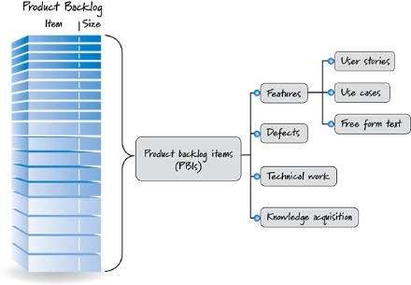
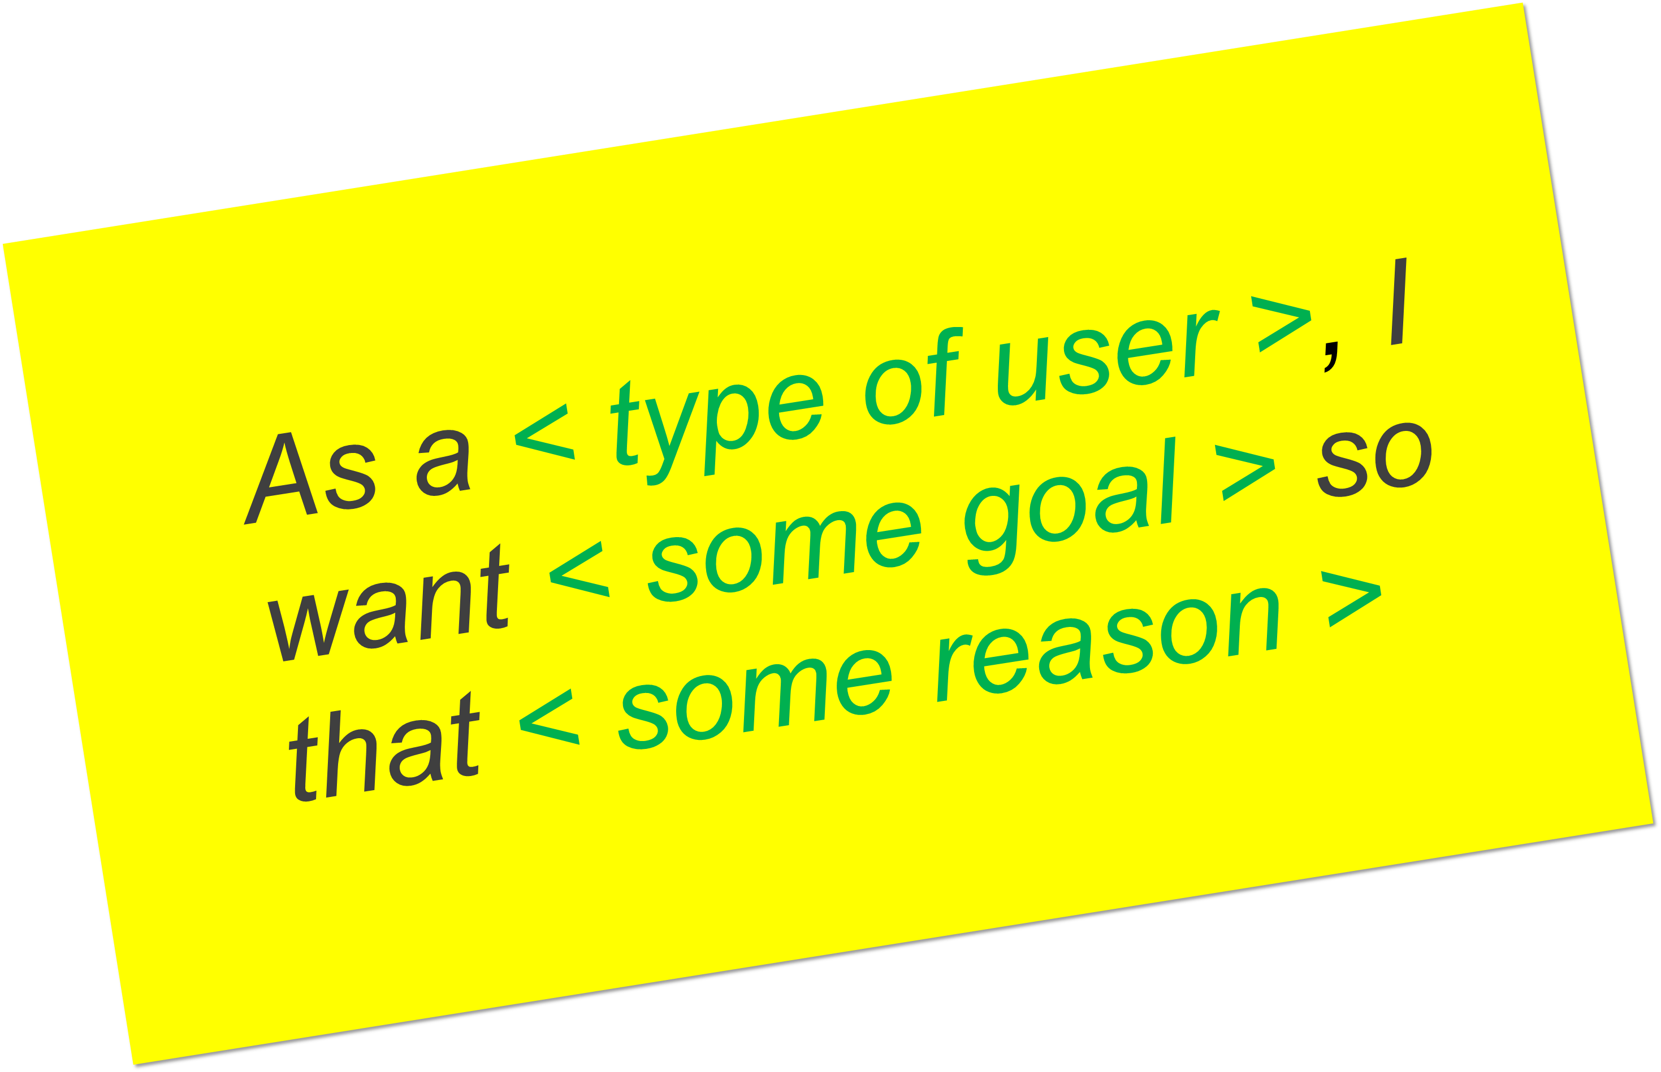
Scrum Artifacts: Product Backlog Items
User Story 1
User Story 2
Feature 1
Sprint Backlog
User Story 3
Epic 1
Feature 2
User Story 4
Feature 3
Product Backlog Items (PBIs)
Product Backlog Items include business backlog items and end-user functionality as well as nonfunctional technical enabler stories - technical work items that are created to support the development of the business initiatives
Epic 2

Slide 25
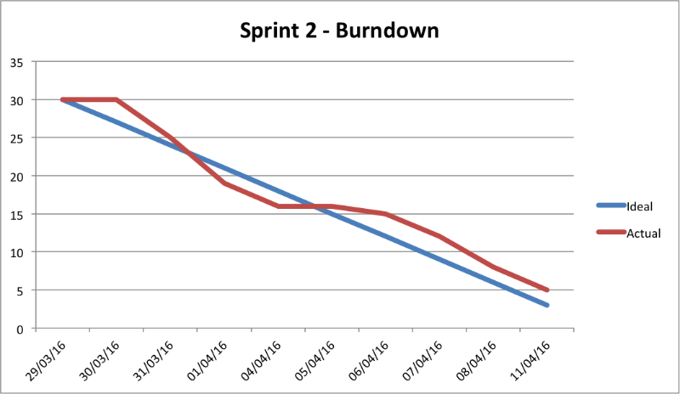
Scrum Artifacts: Burndown Chart
The Burndown Chart is a real-time, visual guide that shows the actual and estimated amount of work to be done in a sprint and is updated on a day-to-day basis.
The Burn down chart can tell us:
Work expressed in effort (story points) or hours for the sprint
Work remaining
Work done so far
If we are on track to complete work by the sprint end date
Notes:
The Burn down Chart shows the actual and estimated amount of work to be done in a sprint and is updated on a day-to-day basis.
It is used as a visual tool to guide the development team to successful completion of a Sprint on time with a working final product.
By reviewing a sprint Burn down report, you can track how much work remains in a sprint, understand how quickly your team has completed tasks, and predict when your team will achieve the goals of the sprint.
The horizontal x-axis on a Burn down Chart indicates days in the sprint, and the vertical y-axis measures the amount of work that remains to complete the tasks in the sprint. The work that remains is generally shown in hours but may also be shown in story points or number of tasks.
The Burn down chart can tell us:
Work expressed in effort (story points) or hours for the sprint
Ideal and Actual Velocity
Work remaining
Work done so far
If we are on track to complete work by the sprint end date

Slide 26
Session Retrospective
Notes:
Stop Start Continue

Slide 27
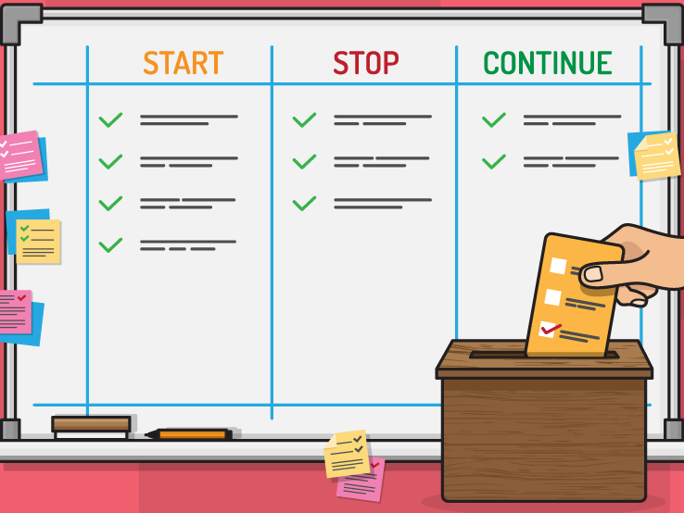
Session Retrospective
Notes:
Facilitator leads retro of training, one category at a time with action items at the end.
Create a safe and courageous space to tell the truth and grow.

